Slide 1
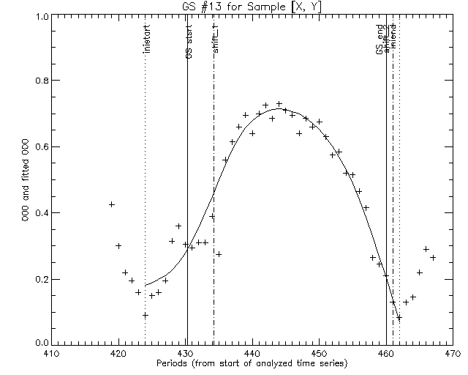
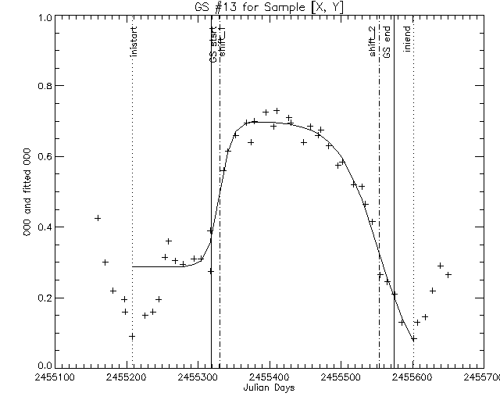

Slide 2
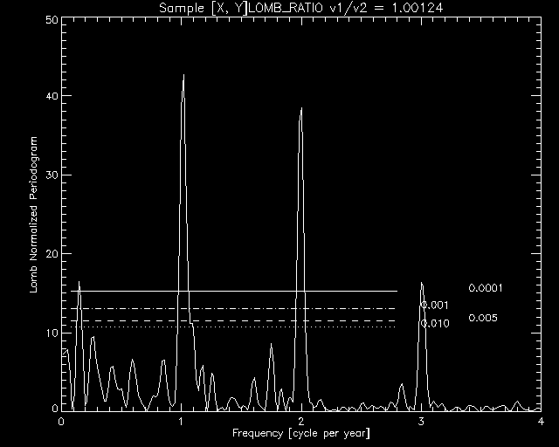
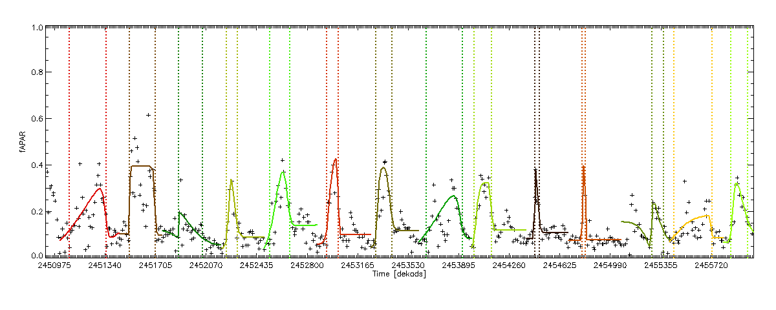
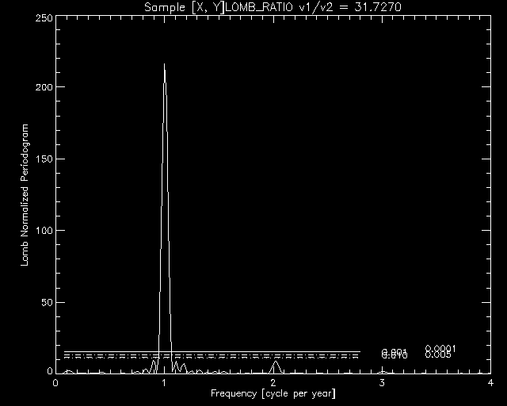
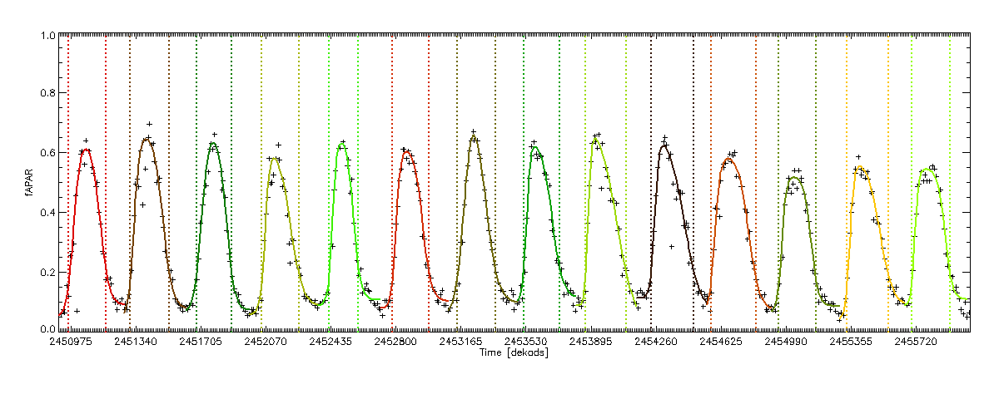
sample = 2175
line = 3373
sample = 1020
line = 2260

Slide 3
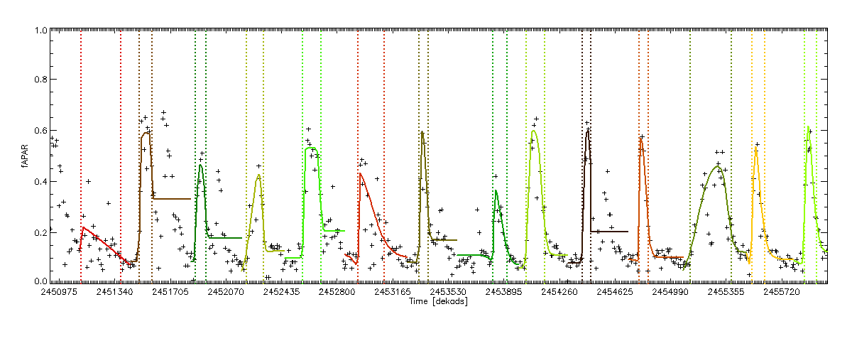
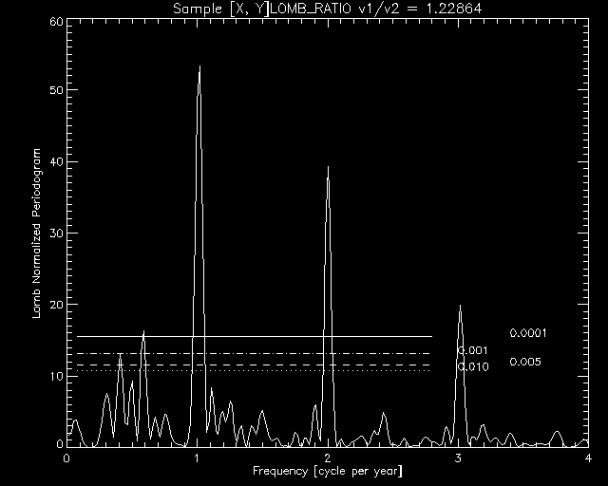
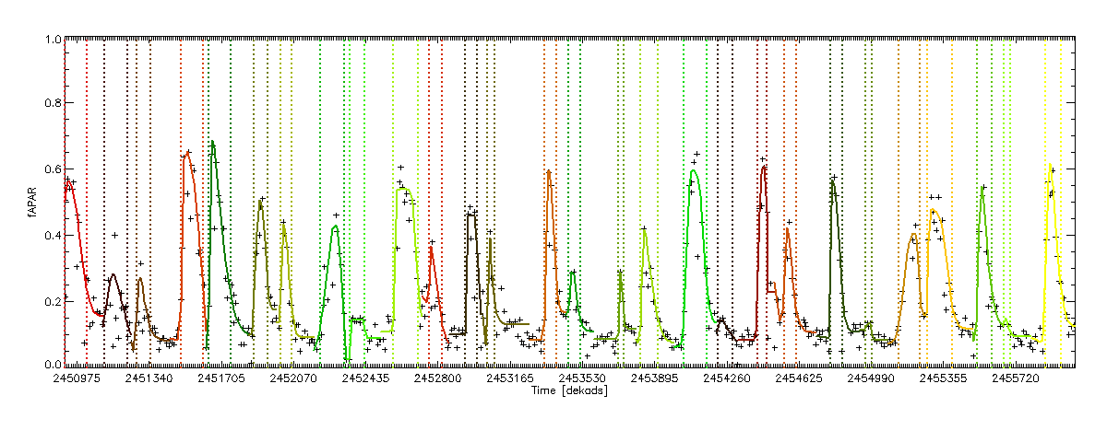
sample = 2091
line = 3360
LombRat = 1.2
Autocorrelogram
Lomb Normalized Periodogram

Slide 4
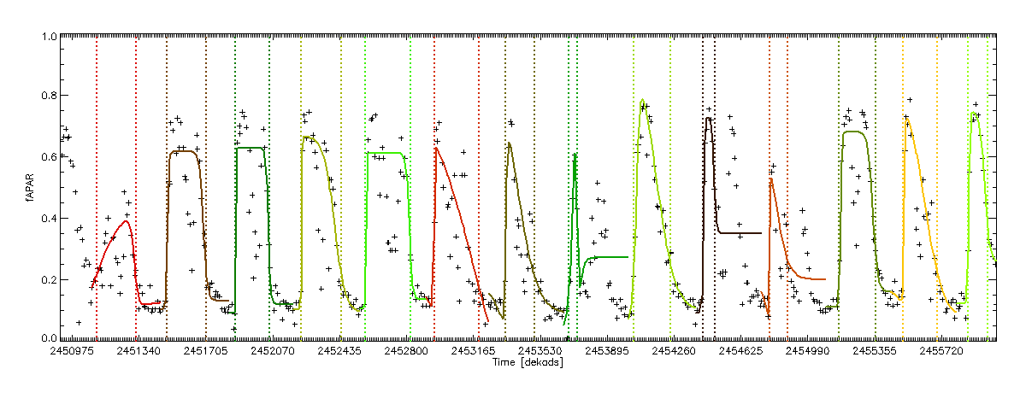
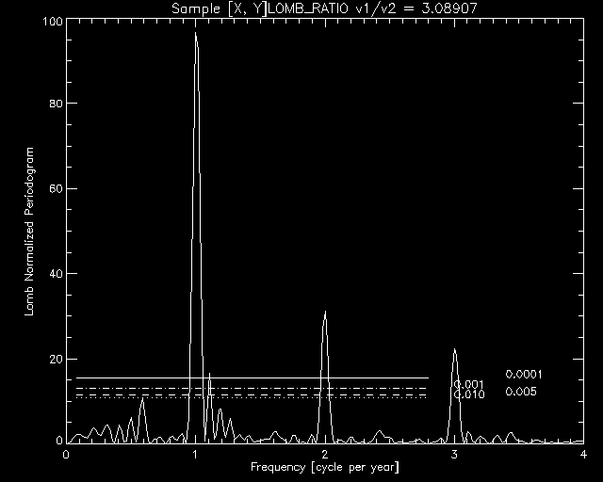
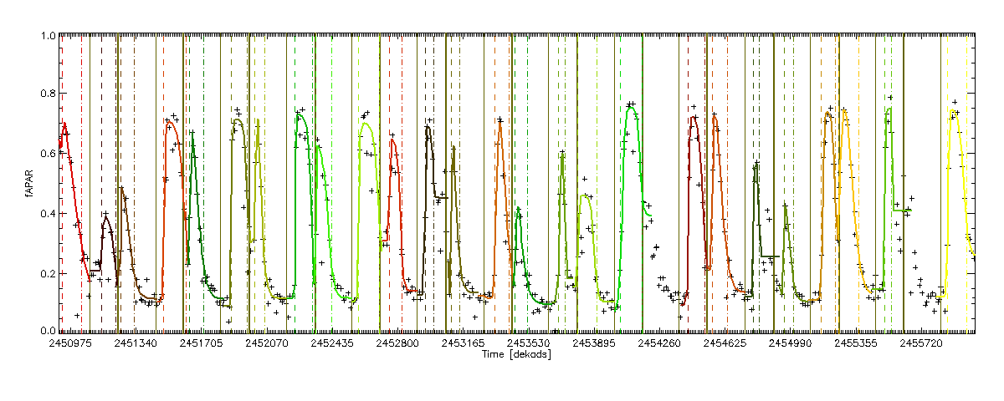
sample = 2050
line = 3387
LombRat = 3.0
Autocorrelogram
Lomb Normalized Periodogram

Slide 5
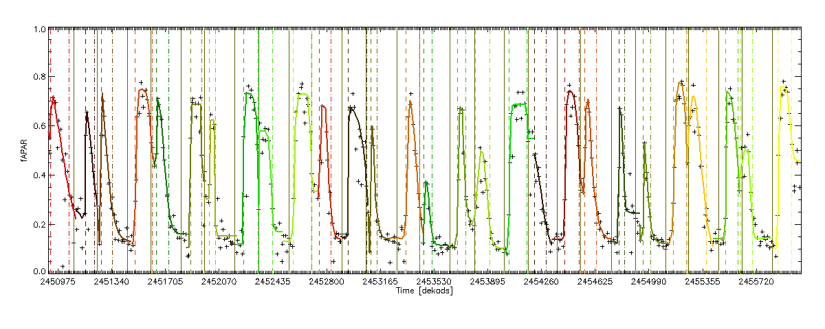
sample = 2046
line = 3389
LombRat = 4.96
Autocorrelogram
Lomb Normalized Periodogram

Slide 6
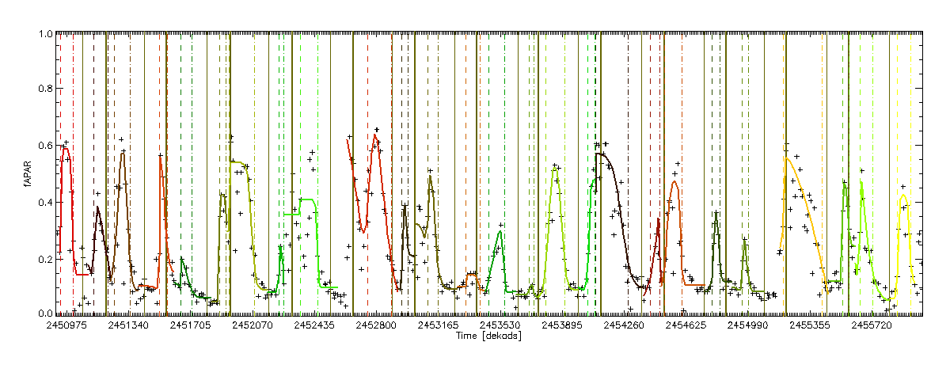
sample = 1905
line = 3383
LombRat = 5.58
Autocorrelogram
Lomb Normalized Periodogram

